Slide 1

CMIP5 based climate change projections for South Asia: its application in IVA studies, an example of KH region
2nd WCRP CORDEX South Asia Workshop, 27-30 August, 2013, Kathmandu
Dr. Rajiv Kumar Chaturvedi
National Environmental Sciences Fellow
Indian Institute of Science
Bangalore-12

Slide 2
Part 1: CMIP5 based multi-model climate change projections for India
Based on Chaturvedi RK., Joshi, J., Jayaraman, M., Bala, G., Ravindranath, N.H (2012)

Slide 3
MOTIVATION & OBJECTIVES
Availability of RCP scenarios replacing the 15 year old SRES scenarios.
By May 2012, temp and precipitation data was available from 18 CMIP5 ESMs.
CMIP5 ESMs are available on better resolution (1-2.8°) than the previous CMIP3 models
Goal was to have a first cut assessment of: a) reliability of CMIP5 ESMs for India, and b) uncertainty in their temperature and precipitation projections over the Indian region

Slide 4
S. N. | Model | ModelingCenter (or Group) | lat – deg | lon – deg
1 | BCC-CSM1-1-M | Beijing Climate Center, China Meteorological Administration | 1.125 | 1.125
2 | CCSM4 | National Center for Atmospheric Research, USA | 0.942 | 1.25
3 | CESM1(CAM5) | Community Earth System Model Contributors | 0.937 | 1.25
4 | GISS-E2-H | NASA Goddard Institute for Space Studies, USA | 1.12 | 1.12
5 | IPSL-CM5A-MR | Institut Pierre-Simon Laplace, France | 1.12 | 1.125
6 | MRI-CGCM3 | Meteorological Research Institute, Japan | 1.132 | 1.125
1 | BCC-CSM1.1 | Beijing Climate Center, China Meteorological Administration | 2.812 | 2.812
2 | CSIRO-Mk3.6 | Commonwealth Scientific and Industrial Research Organization in collaboration with Queensland Climate Change Centre of Excellence, Australia | 1.895 | 1.875
3 | FIO-ESM | The First Institute of Oceanography, SOA, China | 2.812 | 2.812
4 | GFDL-CM3 | NOAA Geophysical Fluid Dynamics Laboratory | 2 | 2.5
5 | GFDL-ESM2G | NOAA Geophysical Fluid Dynamics Laboratory | 2 | 2.5
6 | GFDL-ESM2M | NOAA Geophysical Fluid Dynamics Laboratory | 2 | 2.5
7 | GISS-E2-R | NASA Goddard Institute for Space Studies, USA | 2.022 | 2.517
8 | HadGEM2-AO | Met Office Hadley Centre, UK | 1.241 | 1.875
9 | HadGEM2-ES | Met Office Hadley Centre, UK | 1.25 | 1.875
10 | IPSL-CM5A-LR | Institut Pierre-Simon Laplace, France | 1.895 | 3.75
11 | MIROC5 | The University of Tokyo | 1.417 | 1.406
12 | MIROC-ESM | The University of Tokyo | 2.857 | 2.813
13 | MIROC-ESM-CHEM | The University of Tokyo | 2.857 | 2.813
14 | NorESM1-M | Norwegian Climate Centre | 1.895 | 2.5
15 | NorESM1-ME | Norwegian Climate Centre | 1.875 | 2.5

Slide 5
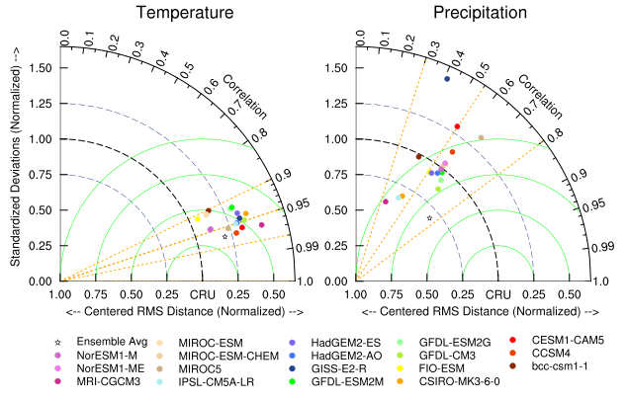
VALIDATION OF CMIP5 CLIMATE PROJECTIONS FOR INDIA (1971-2000) : A TAYLOR DIAGRAM APPROACH
Can we prioritize the model for future regional downscaling based on their performance on the Taylor diagram?
Chaturvedi RK., Joshi, J., Jayaraman, M., Bala, G., Ravindranath, N.H (2012)

Slide 6
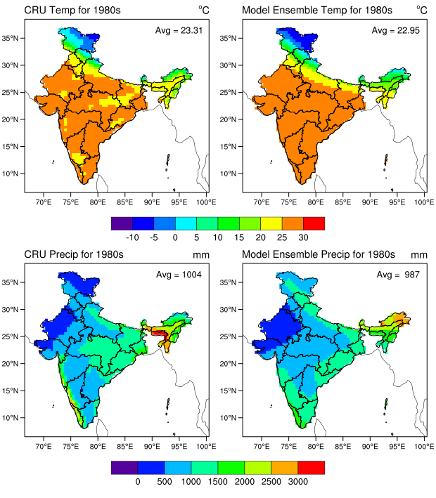
VALIDATION OF CMIP5 CLIMATE PROJECTIONS FOR INDIA
Chaturvedi et al., 2012

Slide 7
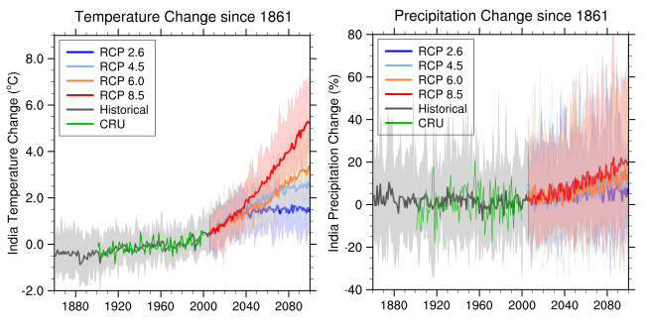
MULTI-MODEL APPROACH TO CAPTURE UNCERTAINTIES IN TEMPERATURE AND PRECIPITATION PROJECTIONS OVER INDIA
Baseline = 1961-1990
Chaturvedi et al., (2012)

Slide 8
WHICH COULD BE THE MOST LIKELY SCENARIO?
Fossil Fuel based emissions
Gt C/Yr
Fossil Fuel based emissions

Slide 9
WHICH COULD BE THE MOST LIKELY SCENARIO?
Gt C/Yr
Does RCP 4.5 represent the future risks adequately?

Slide 10
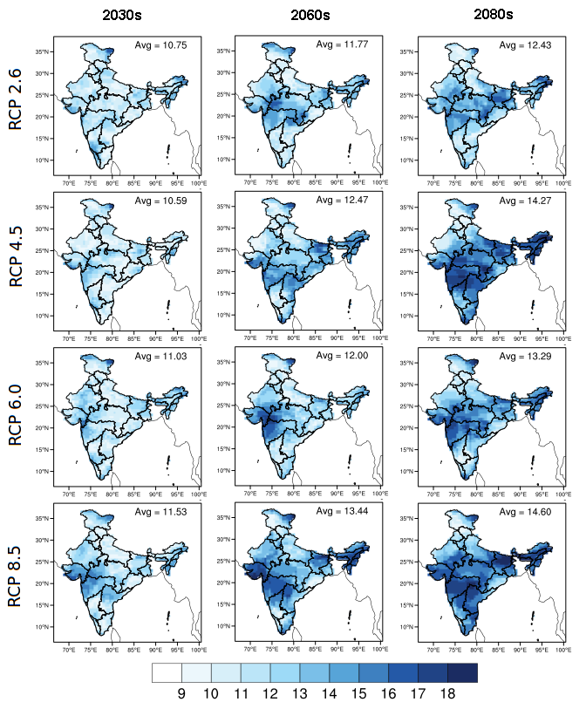
PRECIPITATION PROJECTIONS FOR INDIA AND THEIR RELIABILITY
Baseline = 1961-1990
Chaturvedi et al., 2012

Slide 11
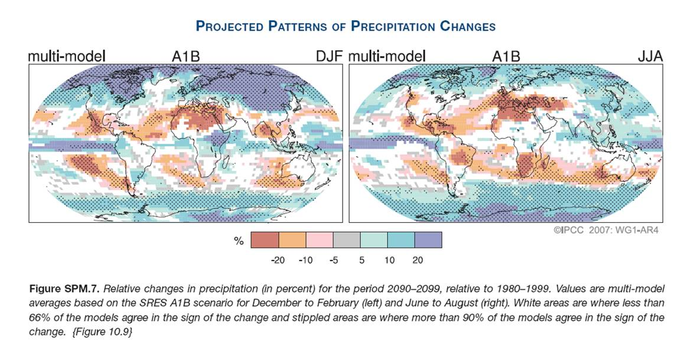
IPCC multi-model precipitation projections -2007

Slide 12
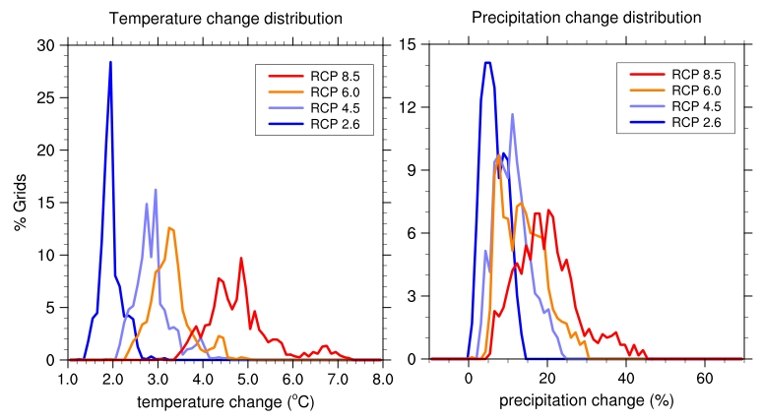
CMIP5 model ensemble based grid wise distribution of temperature and precipitation change under different RCP scenarios for India for 2080s (2070-2099) relative to pre-industrial period (1880s i.e over 1861-1900)

Slide 13
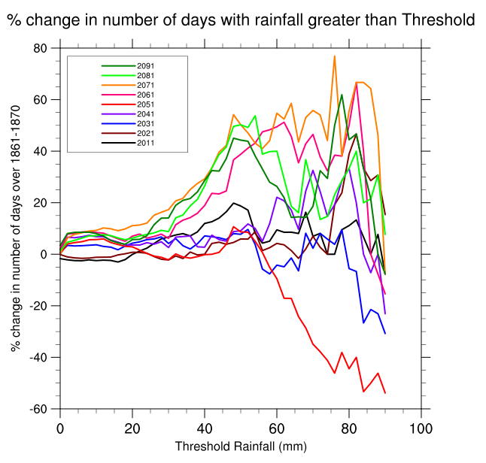
PROJECTED CHANGE IN THE FREQUENCY OF EXTREME RAINFALL DAYS FOR FUTURE DECADES RELATIVE TO 1861-1870 BASELINE BASED ON MIROC-ESM-CHEM MODEL FOR RCP SCENARIO 4.5
Chaturvedi et al., 2012

Slide 14
Part 2: Application of climate data in IVA studies: An example - Impact of climate change on the glacial mass balance in Karakoram and Himalayas
Based on Chaturvedi, RK., Kulkarni, A., Karyakarte, Y., Joshi, J., Bala, G (Under consideration with climatic change)

Slide 15
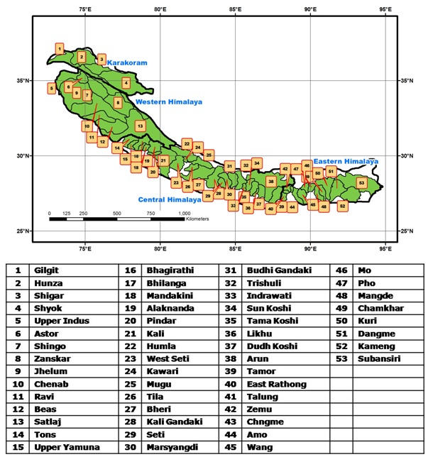
STUDY AREA

Slide 16
MOTIVATION
Bolch et al (2012) provided improved data on the hypsometry of glaciers in KH region
We wanted to apply the statistical relationship between AAR and mass balance as proposed by Kulkarni et al (2004)
Availability of somewhat improved CMIP5 projections from 21 ESMs

Slide 17
BROAD OBJECTIVES
In the light of Himalayan blunder by IPCC, we were curious to have some ‘order of magnitude’ or ‘first cut’ estimate on what happens to mass balance of KH glaciers under climate change scenarios over the 21st century

Slide 18
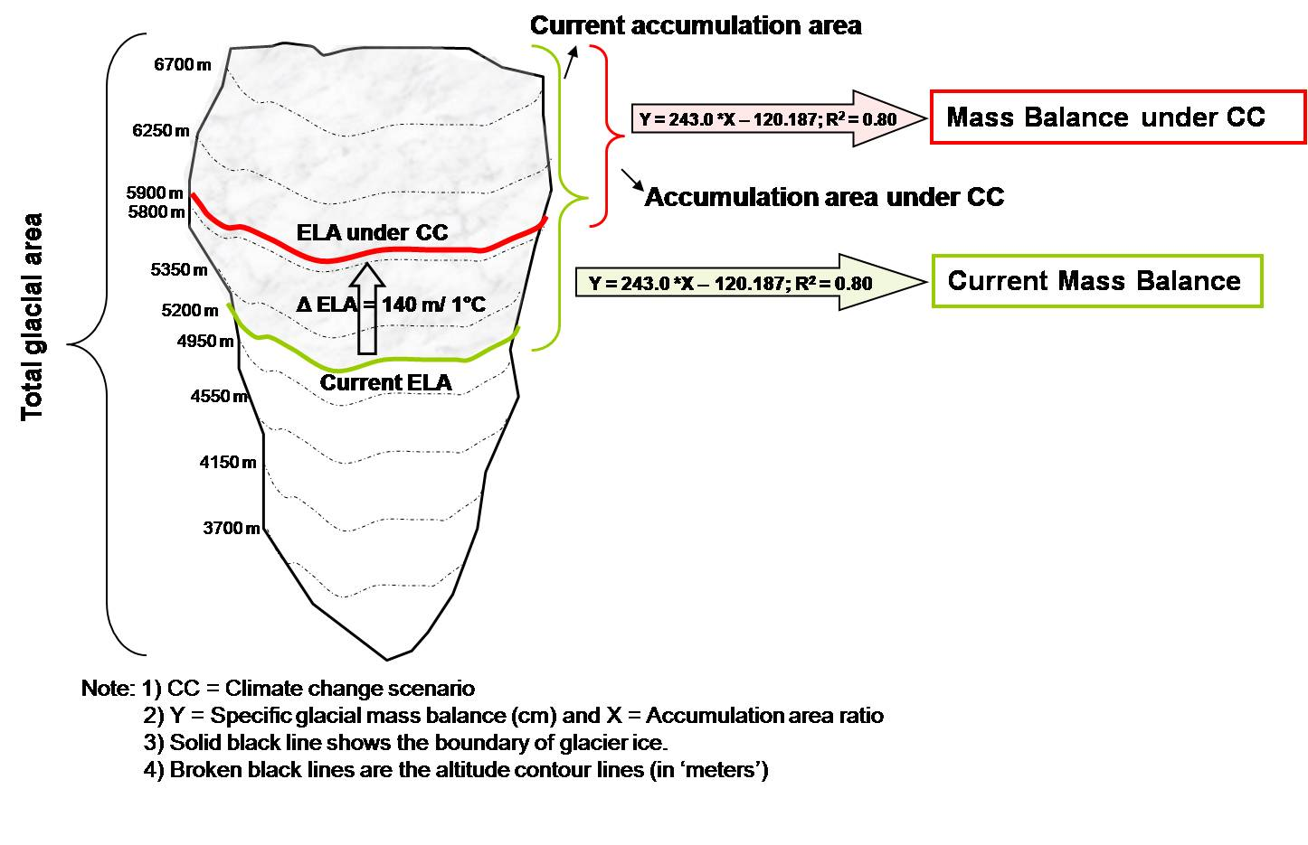
THE MODEL

Slide 19
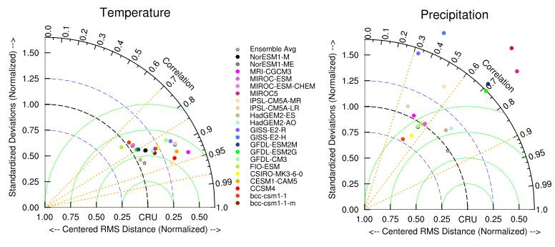
HOW RELIABLE ARE CMIP5 ESMS FOR THE K-H REGION?

Slide 20
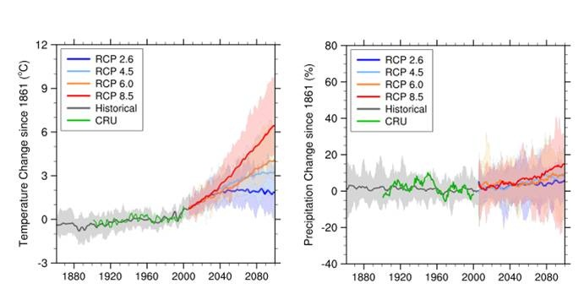
RANGE OF UNCERTAINTIES IN THE TEMPERATURE AND PRECIPITATION PROJECTIONS FOR THE K-H REGION

Slide 21
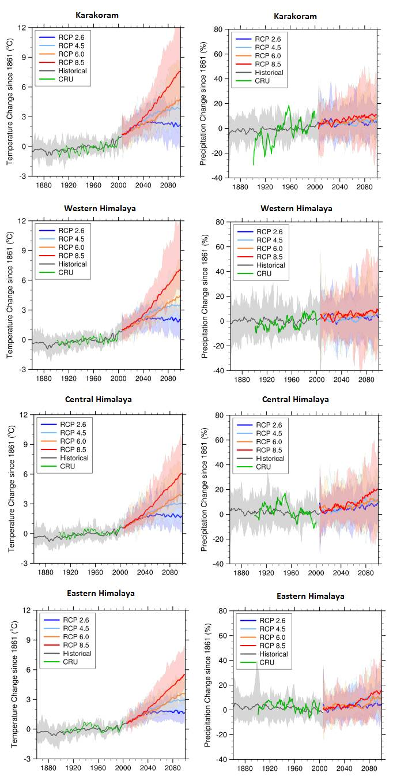

Slide 22
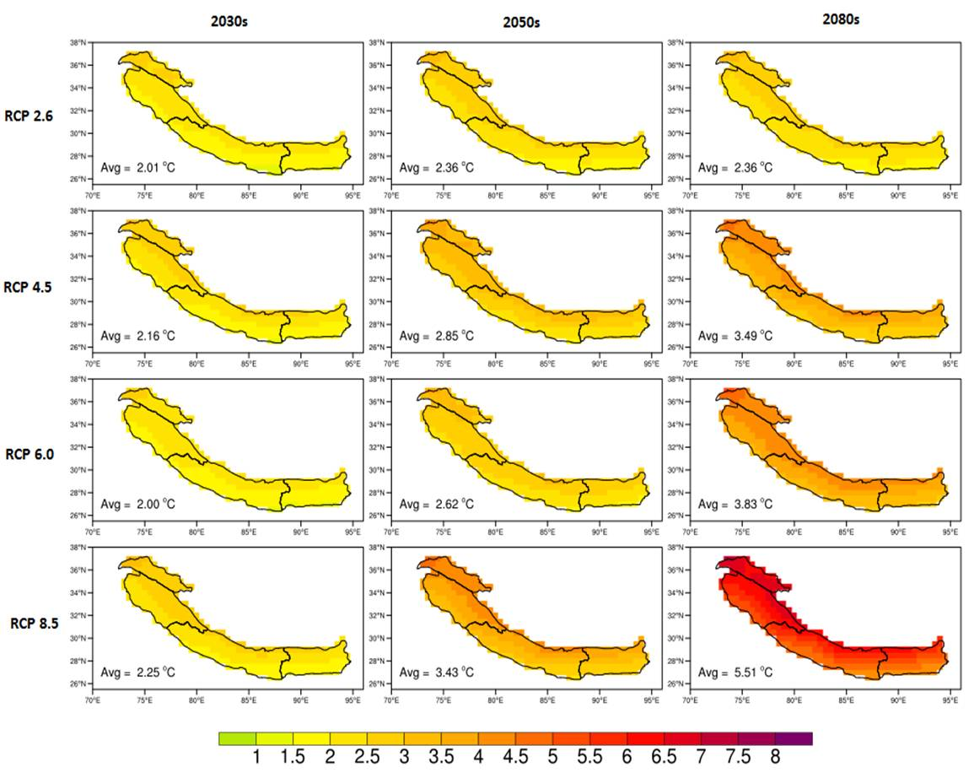
TEMPERATURE PROJECTIONS FOR HINDUKUSH AND HIMALAYA

Slide 23
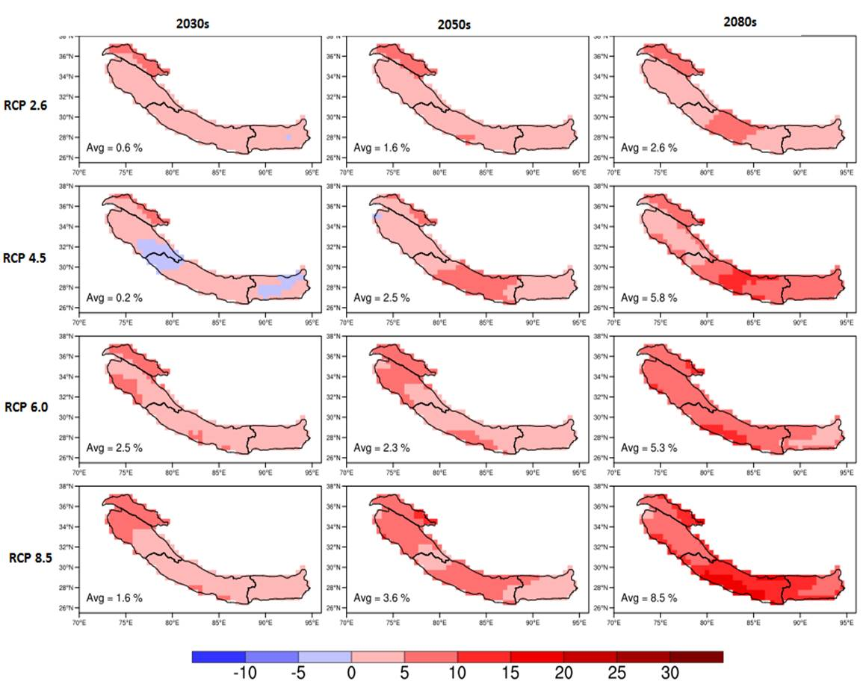
PRECIPITATION PROJECTIONS FOR HINDUKUSH AND HIMALAYA

Slide 24
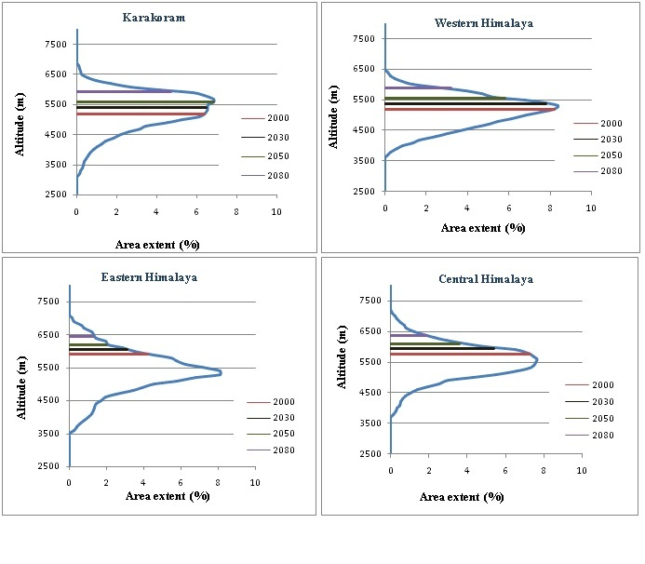
ELA PROJECTIONS UNDER RCP 8.5

Slide 25
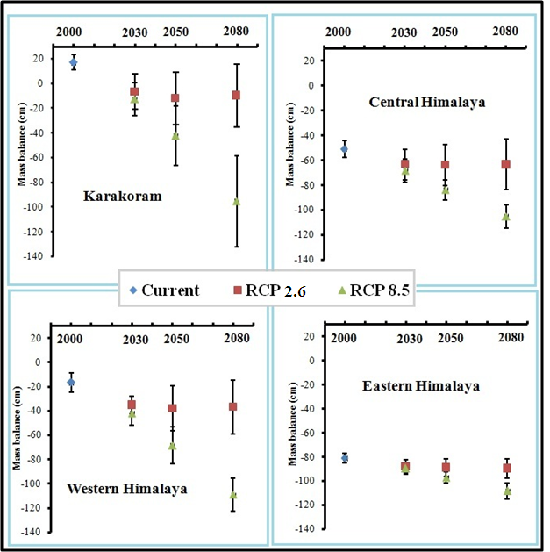
MASS BALANCE CHANGE PROJECTIONS
Errors bars for 2000 represent the uncertainty in current estimates; future uncertainty comes from range in temperature projections (21 models)

Slide 26
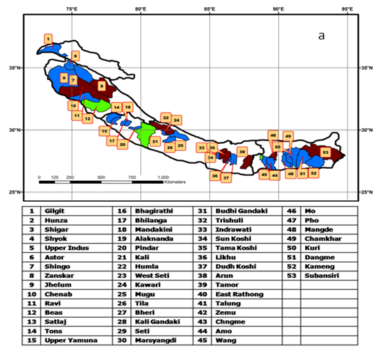
GLACIERS AT THE RISK OF TERMINAL RETREAT
RCP 8.5 scenario: Basins showing terminal retreat by 2030s are shown in blue, by 2050s in green and by 2080s in brown.

Slide 27
CONCLUSIONS
The glacial mass loss for the entire KH region for the period 1995 to 2005 was -6.6±1 Gt yr-¹ which increases by approximately six fold to -35±2 Gt yr-¹ by the 2080s under the high emission scenario of RCP8.5.
However, under low emission scenario of RCP2.6 the glacial mass loss only doubles to -12 ±2 Gt yr-¹ by the 2080s.
We also find that 10.6 to 27% of glaciers could face eventual disappearance by 2080s, thus underscoring the threat to water resources under high emission scenarios.

Slide 28
UNCERTAINTIES, LIMITATIONS AND RESEARCH GAPS
High uncertainty in observed climate data
High uncertainty in projections esp. coming from GCMs as for the Hindukush and Himalaya region, resolution of climate data is crucial
Uncertainties in glaciological data

Slide 29
Many thanks

